Slide 1


PRACTICAL GUIDE · MOZAMBIQUE
How to Register a
Company in Mozambique
A step-by-step guide to name reservation, incorporation,
tax registration, publication and licensing.
Tax Advisory — Sociedade Unipessoal, Lda · Maputo, Mozambique
Notes:
Opening slide. Introduce the guide: eight steps, from name reservation to the formal start of activity.

Slide 2


INTRODUCTION
Setting up in Mozambique
There are several ways to proceed to register a company in Mozambique — however, all of them require some form of registration.
8
Steps
From name reservation to the formal start of activity.
The level of registration and legal liability, in general, depends on factors such as the size of the business — whether small, medium or large — and the number of owners or legal shareholders.
Although registering a company in Mozambique may seem complicated in some ways, a set of reforms is underway aimed at simplifying several steps and speeding up processes, providing greater accessibility for all entrepreneurs who wish to start a company.
5
Institutions
Registry, bank, Tax Authority, Imprensa Nacional and the licensing body.
1
Adviser
A single point of contact to run the process end to end.
02 · Tax Advisory
Notes:
Set the scene: the process is sequential, each step produces a document the next one needs.

Slide 3
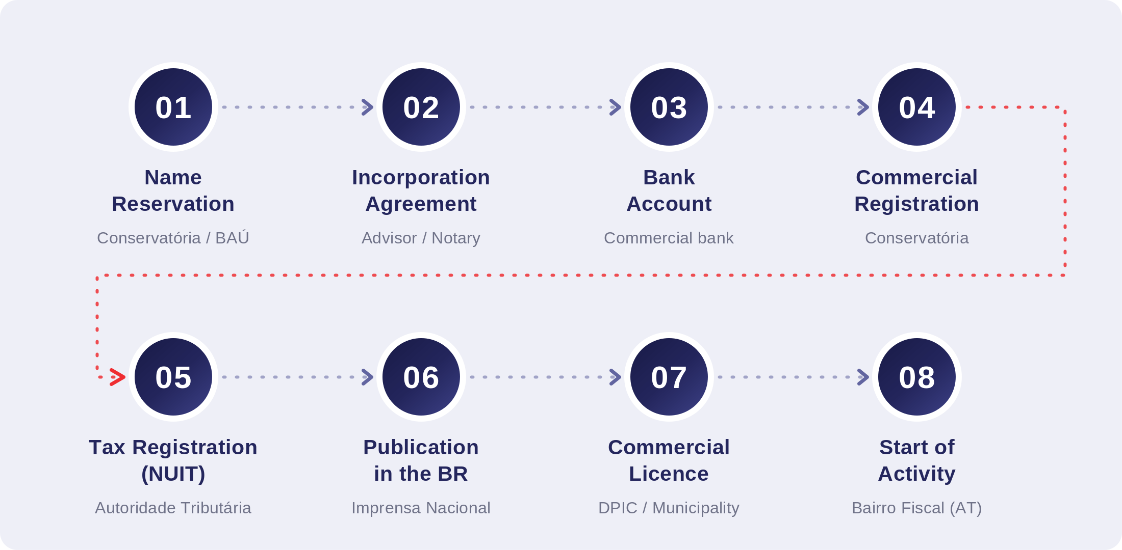
OVERVIEW
The process at a glance
Each step must generally be completed in order — every one produces a document required by the next.
03 · Tax Advisory
Notes:
Walk the room through the eight steps. Note that step 4, commercial registration, is what produces the definitive certificate.

Slide 4

STEP 01
Name Reservation
WHERE Conservatória do Registo das Entidades Legais, or a Balcão de Atendimento Único (BAÚ)
Name reservations are made at the Conservatória do Registo de Pessoas Jurídicas (Legal Entities Registry) or at a Balcão de Atendimento Único (One-Stop Shop). The partners or sole shareholder must present the company, its intended activity and the sector in which it will operate, and state the value of the investment.
The name must be chosen in advance and checked at the Commercial Registry Office to determine whether the name in question — or one very similar to it — does not already exist. The name will always be followed by an indication of the legal form of the company.
IN PRACTICE Reserve two or three alternative names — rejections are common and cost you a return trip.
04 · Tax Advisory
Notes:
Step 01 — Name Reservation. Responsible body: Conservatória do Registo das Entidades Legais, or a Balcão de Atendimento Único (BAÚ).

Slide 5

STEP 02
Drafting of the Incorporation Agreement
WHERE Prepared with your advisor; executed before a notary
With the help of an advisor, the articles of association (pacto social) are drawn up, establishing the object of the company — the line of business that the company intends to pursue.
The same articles contain the names of the partners or the sole partner, with the respective share capital, distributed in quotas if there is more than one partner, or a single quota if there is only one. The registered address, the type of company and the intentions of the future partners also form part of the articles.
IN PRACTICE The corporate object drives the CAE code and therefore the licensing route — get it right at drafting stage.
05 · Tax Advisory
Notes:
Step 02 — Drafting of the Incorporation Agreement. Responsible body: Prepared with your advisor; executed before a notary.

Slide 6

STEP 03
Opening a Bank Account
WHERE Any commercial bank operating in Mozambique
One of the phases of company registration in Mozambique is the opening of a bank account for the purpose of depositing the share capital. This requires a certified copy of the certificate of the company name, the company statutes and certified copies of the identification documents of the shareholders.
When opening the account in the name of the future company, it is important to define the number of authorised signatures that can bind the company for the handling of cheques and transfers.
IN PRACTICE Decide the signature rules now — changing them later needs a fresh resolution and a new bank instruction.
06 · Tax Advisory
Notes:
Step 03 — Opening a Bank Account. Responsible body: Any commercial bank operating in Mozambique.

Slide 7

STEP 04
Commercial Registration
WHERE Conservatória do Registo das Entidades Legais
The articles of association are submitted to the Conservatória for definitive commercial registration. Once the registration is concluded, the Conservatória issues the definitive certificate (certidão) and arranges for the articles to be published.
These are the documents required for every step that follows — tax registration, publication and licensing all depend on them.
IN PRACTICE This is the step the original guide omitted; nothing downstream can proceed without the definitive certificate.
07 · Tax Advisory
Notes:
Step 04 — Commercial Registration. Responsible body: Conservatória do Registo das Entidades Legais.

Slide 8

STEP 05
Tax Registration and Obtaining the NUIT
WHERE Autoridade Tributária de Moçambique
Once the company is legally registered and the statutes have been published in the Official Gazette by the Conservatória, the company must complete its tax registration and obtain the respective Tax Identification Number (NUIT).
IN PRACTICE The NUIT is the key that unlocks invoicing, payroll registration and every subsequent tax obligation.
08 · Tax Advisory
Notes:
Step 05 — Tax Registration and Obtaining the NUIT. Responsible body: Autoridade Tributária de Moçambique.

Slide 9

STEP 06
Publication in the Boletim da República
WHERE Imprensa Nacional de Moçambique
After the issuance of the definitive certificate, the statutes must be published in the Boletim da República so that the company's existence becomes public domain.
This action is only possible upon payment of a fee, which varies according to the number of pages of the articles of association.
IN PRACTICE Longer articles mean a larger publication fee — worth weighing when drafting.
09 · Tax Advisory
Notes:
Step 06 — Publication in the Boletim da República. Responsible body: Imprensa Nacional de Moçambique.

Slide 10

STEP 07
Issue of the Commercial Licence
WHERE Provincial Directorate of Industry and Commerce, or the Municipal Council
The company must first have completed the incorporation process described above. The request is addressed to the Provincial Governor and submitted to the relevant Provincial Directorate of Industry and Commerce, stating the company name, the address of the registered office and the type of commercial activity, in accordance with the Classification of Economic Activities (CAE).
For companies with commercial points such as stores, bakeries, grocery stores and restaurants, licences must be requested from the municipal council instead. The fee varies according to the line of business.
IN PRACTICE Regulated sectors — mining, oil and gas, financial services, telecoms — carry additional licensing beyond this.
10 · Tax Advisory
Notes:
Step 07 — Issue of the Commercial Licence. Responsible body: Provincial Directorate of Industry and Commerce, or the Municipal Council.

Slide 11

STEP 08
Start of Activity
WHERE Bairro Fiscal (Tax Authority representation) for the company's area
After obtaining all of the documentation mentioned above, go to the Bairro Fiscal of the area where the company is located to fill in the appropriate forms and attach the company's existing documentation, in order to start its activity with the Tax Authority.
IN PRACTICE Only after this declaration is the company operational for tax purposes.
11 · Tax Advisory
Notes:
Step 08 — Start of Activity. Responsible body: Bairro Fiscal (Tax Authority representation) for the company's area.

Slide 12
REFERENCE
Documents you will need
The principal documents generated or required during the process, and where each one comes from.
DOCUMENT | SOURCE
Name reservation certificate | Conservatória do Registo das Entidades Legais / BAÚ
Articles of association (pacto social) | Drafted with your advisor; executed before a notary
Certified copies of shareholders' ID documents | Provided by the shareholders
Proof of share capital deposit | Commercial bank
Definitive commercial registration certificate | Conservatória do Registo das Entidades Legais
Publication of the articles | Boletim da República / Imprensa Nacional
NUIT (Tax Identification Number) | Autoridade Tributária de Moçambique
Commercial licence | Provincial Directorate of Industry and Commerce, or Municipal Council
12 · Tax Advisory
Notes:
Use this as the client's checklist. Every item is produced by one of the eight steps.

Slide 13



REFERENCE
Practical notes
Three points that most often catch first-time investors out.
Fees are not fixed
Decide your signatories early
Premises are licensed locally
The Boletim da República publication fee varies with the number of pages of the articles, and the commercial licence fee varies according to the line of business. Budget for both once the articles are final.
When the share capital account is opened, the number of authorised signatures required to bind the company must be defined. Changing this later means a further resolution and a fresh instruction to the bank.
Businesses with a physical commercial point — shops, bakeries, grocery stores and restaurants — are licensed by the municipal council rather than the Provincial Directorate of Industry and Commerce.
13 · Tax Advisory
Notes:
Close the technical part here before moving to the contact slide.

Slide 14

Let us take care of the process.
TAX
Compliance, planning and tax litigation
Tax Advisory assists domestic and international investors through every stage of establishing and maintaining a presence in Mozambique — from name reservation and incorporation to tax registration, licensing and ongoing compliance.
BUSINESS
Accounting, payroll and management reporting
ADDRESS
[ street address ] · Maputo, Mozambique
TELEPHONE
[ +258 ... ]
CORPORATE
E-MAIL
[ e-mail ]
Incorporation, secretarial and governance
WEB
[ website ]
This document is general information only and does not constitute legal or tax advice. Requirements and fees may change; please seek specific advice before acting.
Notes:
Close on the offer of help and the contact details.

